Slide 1
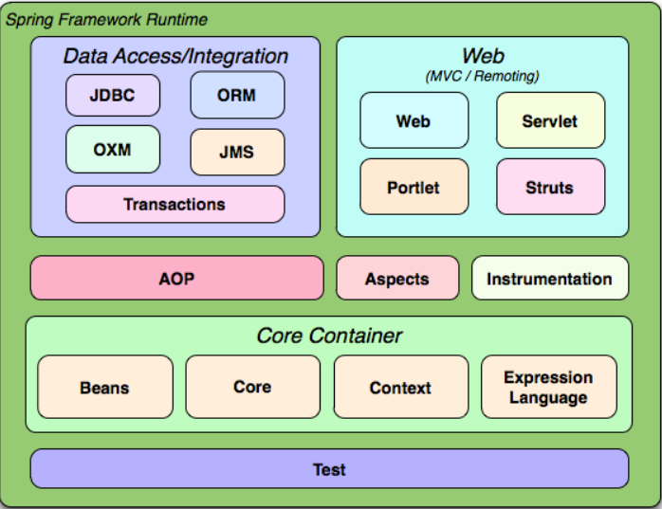

Understanding SPRING

Slide 2
Understanding SPRING
1.Why use Spring IOC ?
2.How to use Spring IOC
3.Hands on – Migrating to Spring IOC
4.Spring AOP

Slide 3
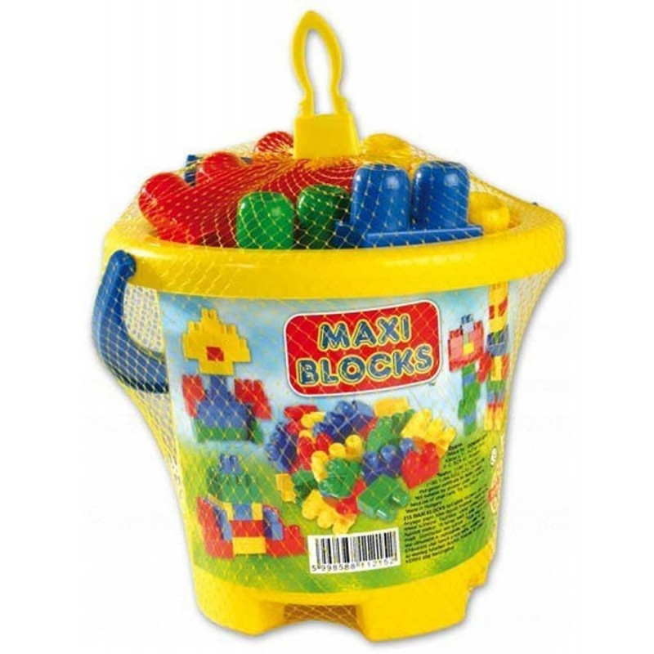
Understanding SPRING
Why use Spring IOC
The role of the Spring IOC is decoupling the instantiation from actual business -> IOC and Dependency Injection
IOC Container -> Framework calls your methods

Slide 4
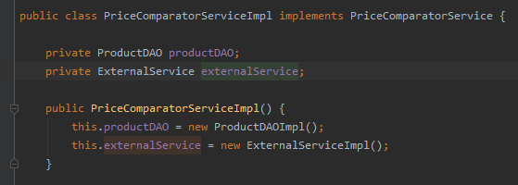
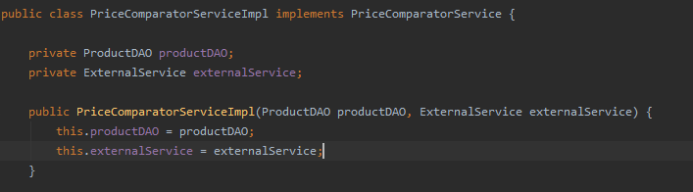
Understanding SPRING
Dependency Injection -> Dependencies are not created by the class, they are passed as parameters to the class
Dependency Inversion -> Classes does not related on concrete dependencies, they relate interfaces which are implemented by concrete classes

Slide 5
Understanding SPRING
How to use Spring
BeanFactory(deprecated) or ApplicationContext -> the place from where you can access all the Spring beans
Bean -> object created and managed by the Spring ApplicationContext

Slide 6
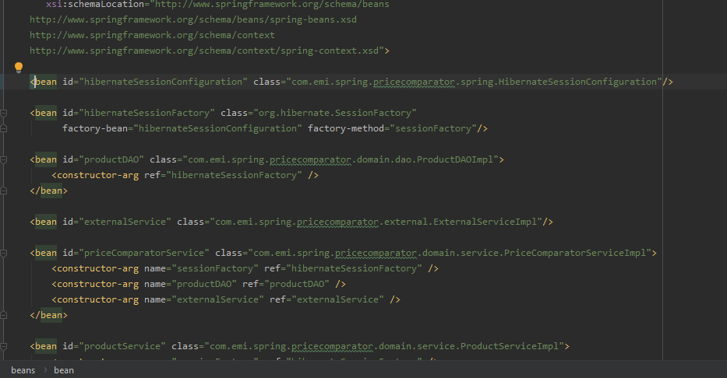
Understanding SPRING
Bean declaration xml

Slide 7
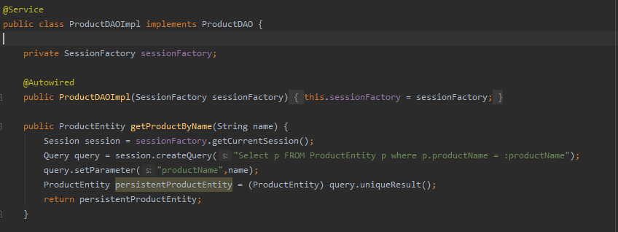
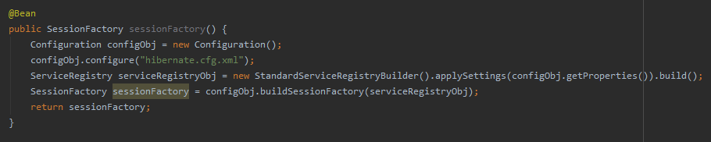
Understanding SPRING
Bean declaration annotations

Slide 8
Understanding SPRING

